Slide 1

Major Project IA -2 Master of Science in Computer Science IV Semester – 2022
School of Computer Science and Applications

Slide 2
A PROJECT REPORT ON An Air Pollution forecasting using LSTM and GRU
Submitted IA-2 Project report completion of MSc degree
Presented by:
Mr. Davada Juned Aslam
SRN: R20SCS06
Internal Guide : Dr. Hemant K S
External Guide :
<number>

Slide 3
Agenda
Abstract
Introduction
Implementation
Result
Conclusion
Bibliography
Research Paper Details
2

Slide 4
ABSTRACT
With the growing of industry we are facing the issue related to the air pollution on the daily basis. The air pollution can produce with the vehicle the chemical factory and many more.
To address this problem of air pollution we are approaching the Deep Learning to overcome this with the help of RNN (Recurrent Neural Network) algorithm which are LSTM(Long-short term memory) and GRU(Gated Recurrent Unit).

Slide 5
Introduction
With the development of industry In last few years , we have to comprise with the air quality quite a lot. Even though we are not getting the air quality as good as earlier.
The air pollution depends upon the different parameters like the if the snow is there on that day then the Pollution will remain low on that day. And if there is no rain or no snow on that day then the pollution will be high on that day.
In real time there are many website which are forecasting the weather but they are not prediction the air pollution.
Our system will forecast the Air pollution similar to the weather forecasting by collecting the previous days data and give it to the model which has created using the LSTM(Long Short term memory) and GRU(Gated Recurrent Unit).

Slide 6
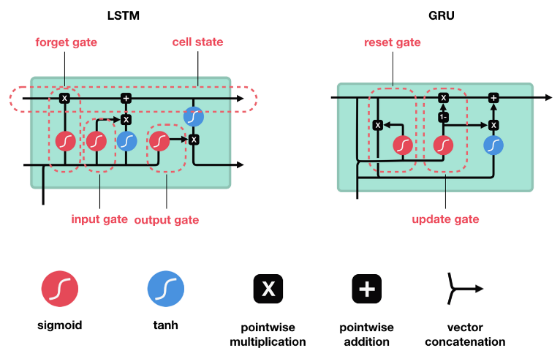
Methodology
In this research we are going to use the famous Recurrent Neural Network algorithm which are LSTM(Long Short term memory) and GRU(Gated Recurrent Unit).
5
<number>

Slide 7
Cont…
We have created a model based on the both the LSTM and GRU. We have added the different layers of LSTM and GRU to it to run it.
The model is quite accurate while forecasting the data for the air pollution.
We have added some layers for the Dropout which will drop out the some of the neurons which are not useful or the neurons which are not sending the data to the next layer.
The optimizer we have used is Adam optimizer with the learning rate of 0.001.
Based on this parameter we have trained the model with the 200 epoch value and 25 step per epoch value.
5

Slide 8
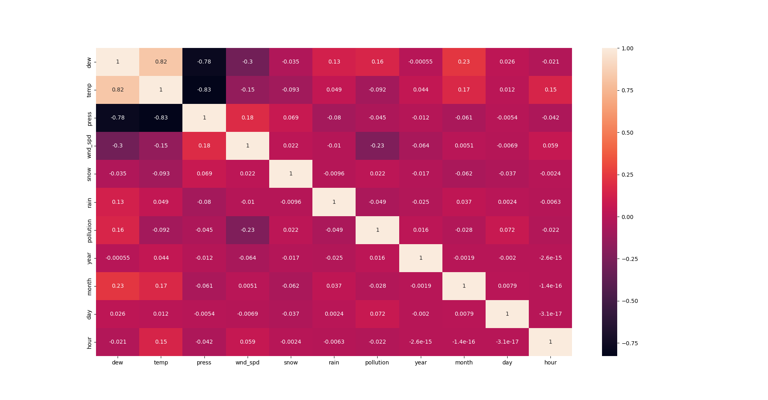
Cont…
The co-relation graph for the dataset is :
5

Slide 9
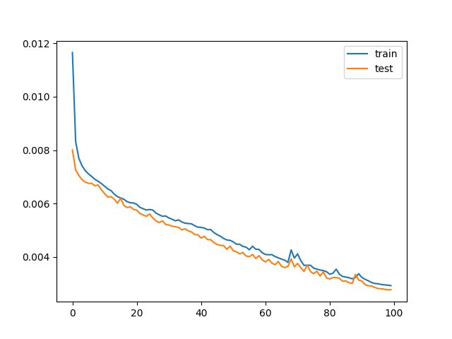
Cont…
We have trained the model with the 3 different epoch value parameter which are 100 , 200 and 300 epoch value.
This is the graph for the 100 epoch value
With loss and Validation loss value.
<number>

Slide 10
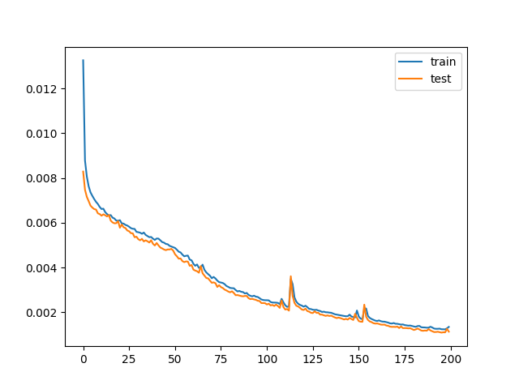
Cont…
This is the graph with the 200 epoch value with the loss and validation loss
<number>

Slide 11
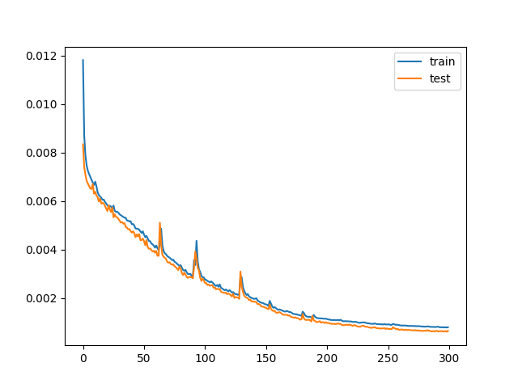
Cont…
This is the graph with 300 epoch value with loss and validation loss.
<number>

Slide 12
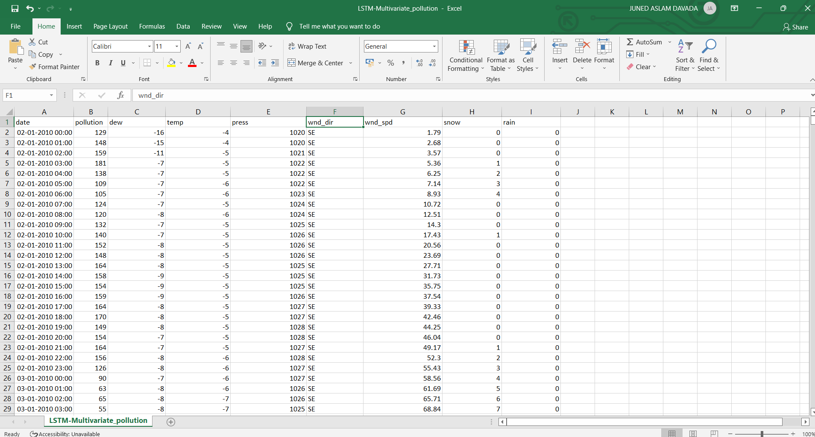
Dataset

Slide 13
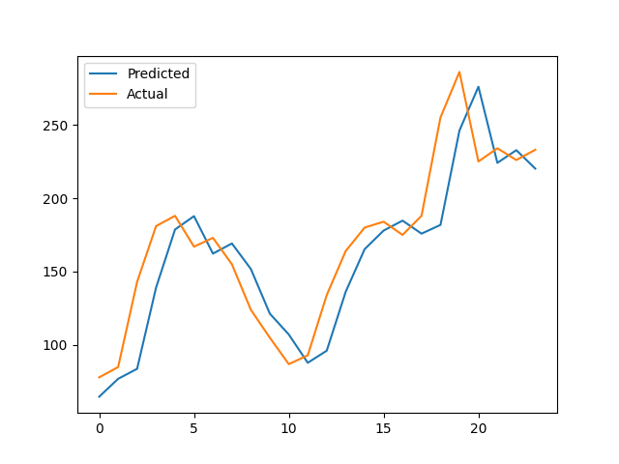
Result
<number>

Slide 14
Cont…
As we can see that the result which the model has predicted based on the data which we have given for the forecasting. The model has generated the quite good result according to the actual values and predicted values.
The actual forecasting of the data will be the graph of next 24 hour of data which has forecasted and the values for that data which has forecasted.
<number>

Slide 15
Conclusion
The project which we have created will forecast the air pollution data based on the previous days data on the hourly basis. The model is quite accurate while forecasting the data for the air pollution.
The model will take the last 15 days of data on hourly basis and predict the next 24 hour of data.
But we can forecast the weather how it is now and what in the next hour we cannot say anything about whether. The model will just forecast the next 24 hours of data based on the data which we have given for the forecasting.
<number>
<number>

Slide 16
Bibliography
K Srinivasa Rao, G. Lavanya Devi, N. Ramesh, "Air Quality Prediction in Visakhapatnam with LSTM based Recurrent Neural Networks", International Journal of Intelligent Systems and Applications(IJISA), Vol.11, No.2, pp.18-24, 2019. DOI: 10.5815/ijisa.2019.02.03
Belavadi, Sagar & Rajagopal, Sreenidhi & R, Ranjani & Mohan, Rajasekar. (2020). Air Quality Forecasting using LSTM RNN and Wireless Sensor Networks. Procedia Computer Science. 170. 241-248. 10.1016/j.procs.2020.03.036.
Q. Tao, F. Liu, Y. Li and D. Sidorov, "Air Pollution Forecasting Using a Deep Learning Model Based on 1D Convnets and Bidirectional GRU," in IEEE Access, vol. 7, pp. 76690-76698, 2019, doi: 10.1109/ACCESS.2019.2921578
X. Du, Y. Cai, S. Wang and L. Zhang, "Overview of deep learning," 2016 31st Youth Academic Annual Conference of Chinese Association of Automation (YAC), 2016, pp. 159-164, doi: 10.1109/YAC.2016.7804882.
<number>

Slide 17
Research paper detail
Paper Name : An online Air pollution Forecasting system using LSTM and GRU
Paper ID : ICICTA-295
<number>

Slide 18
Thank You

